Slide 1
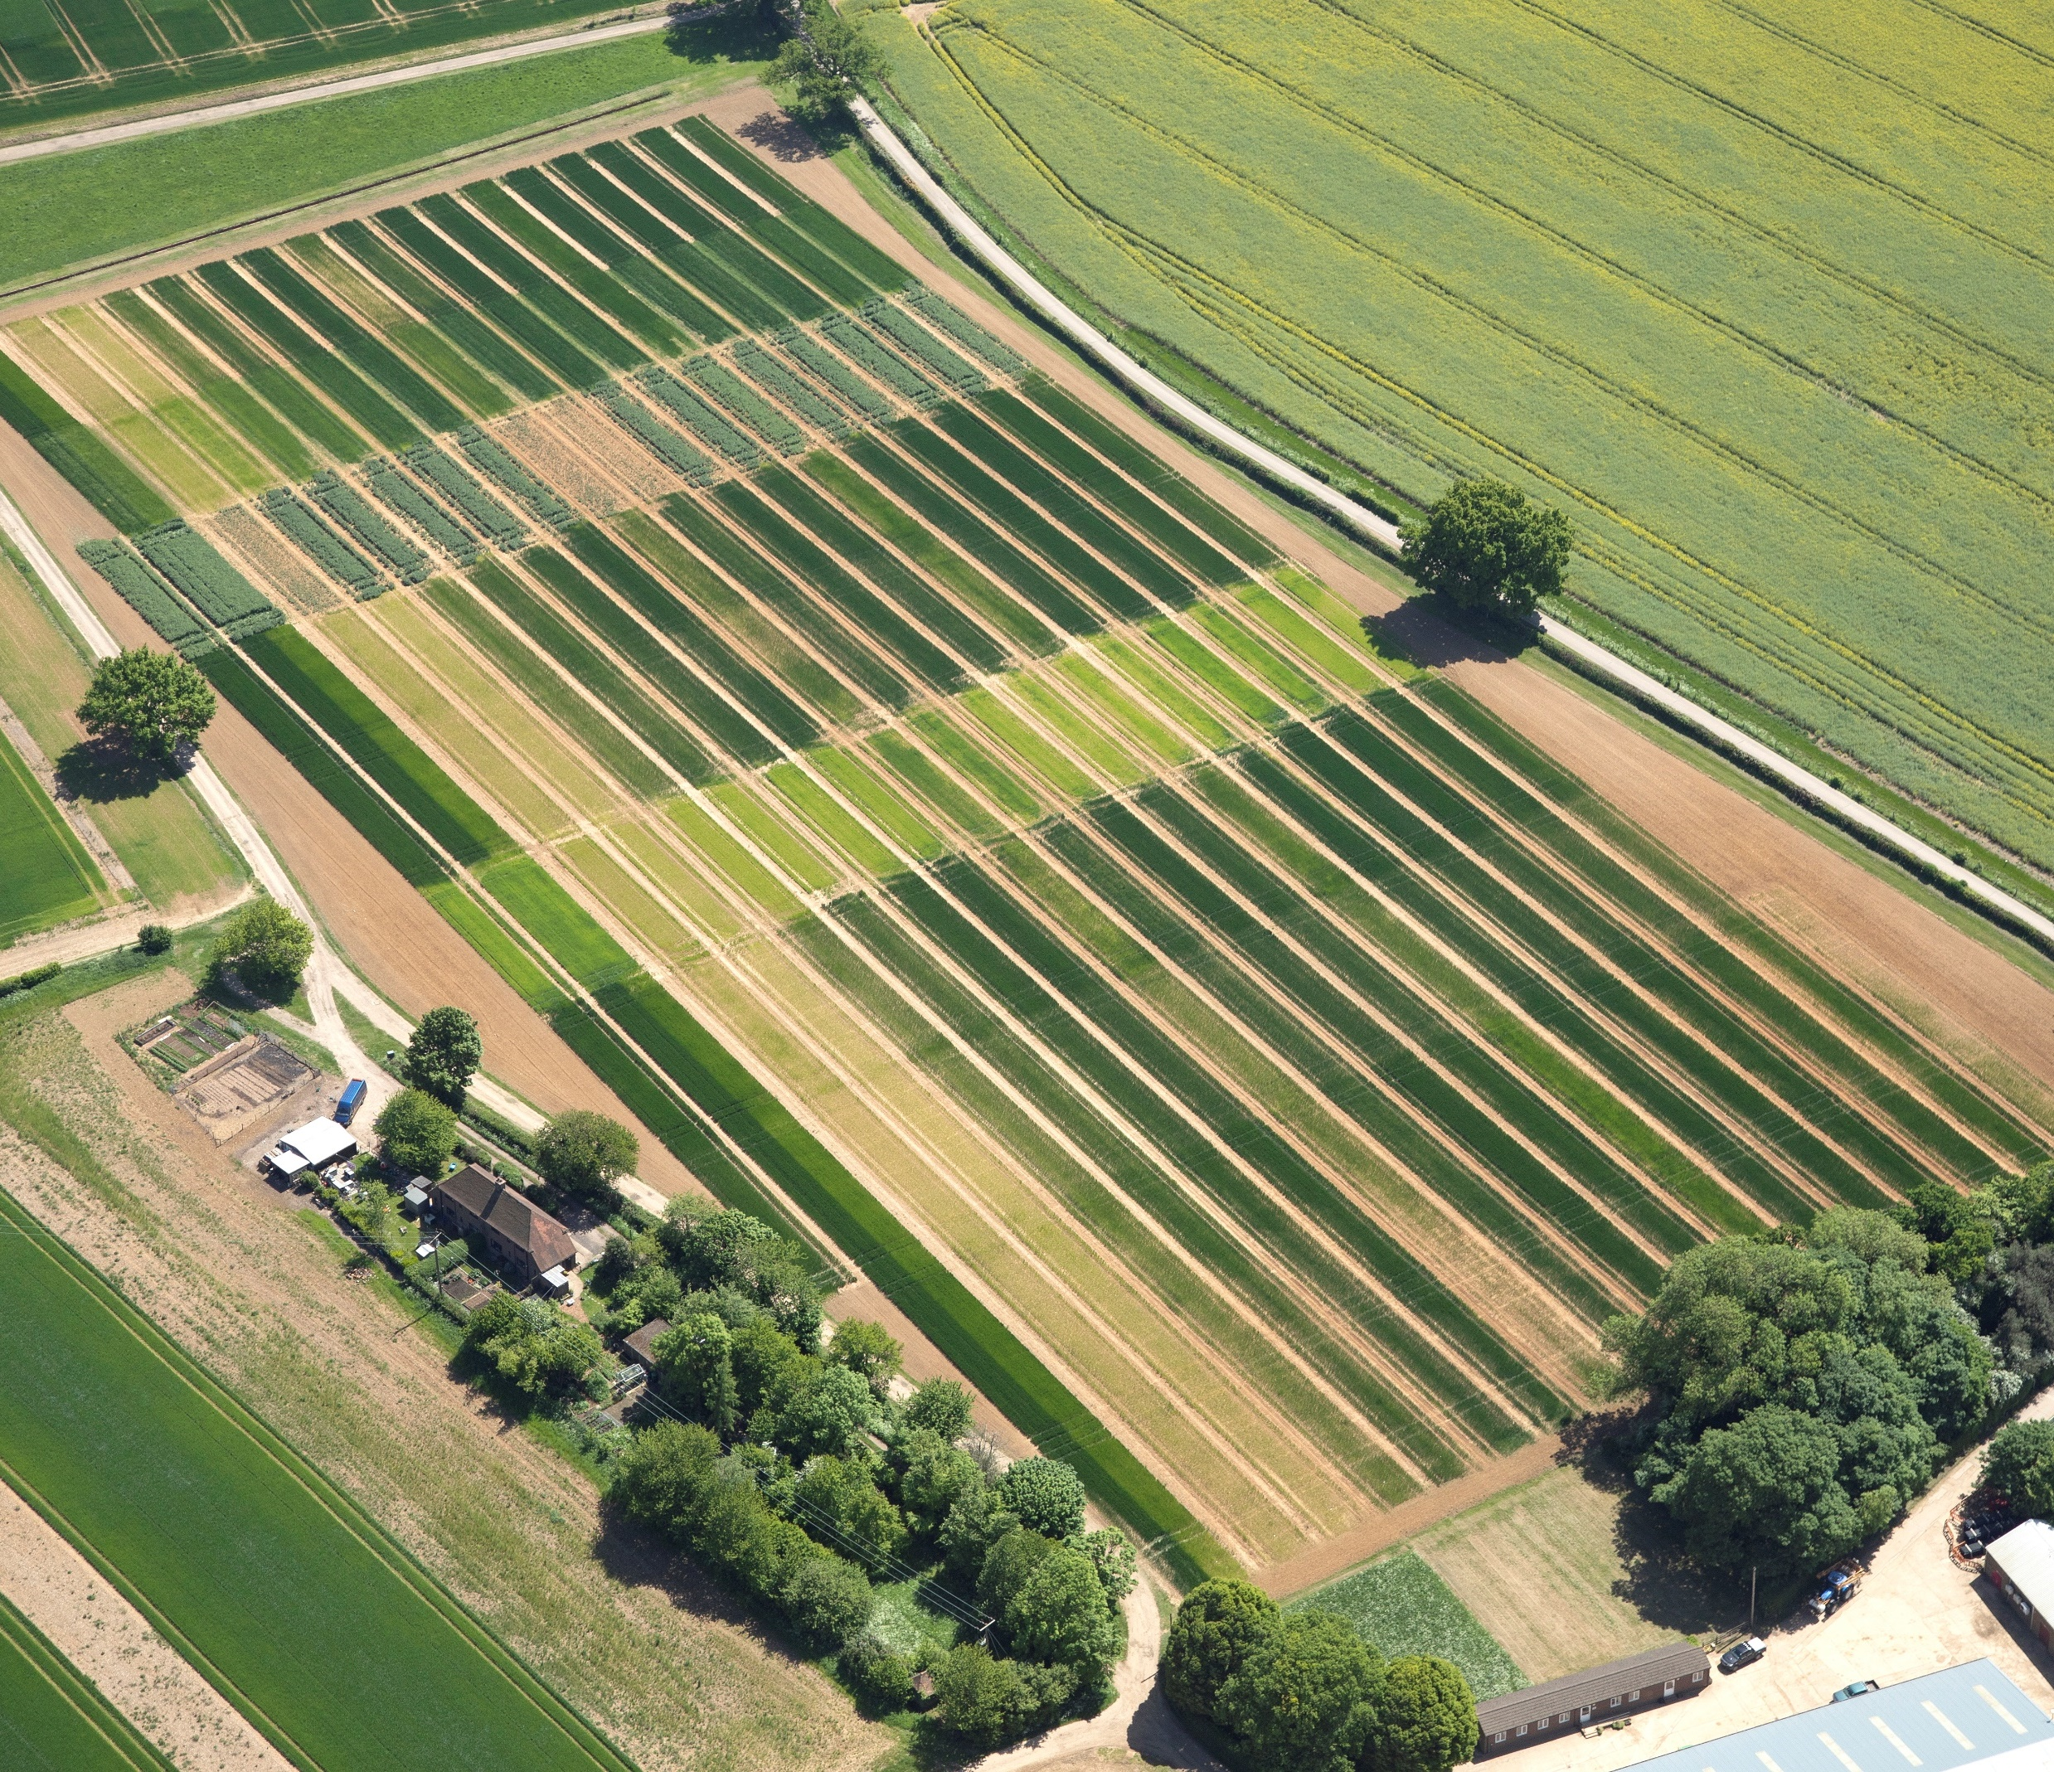
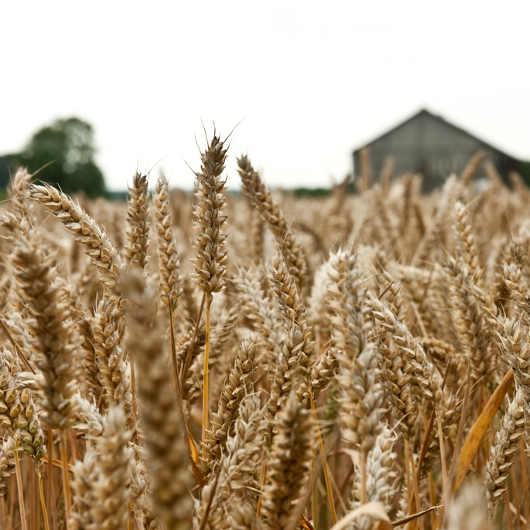
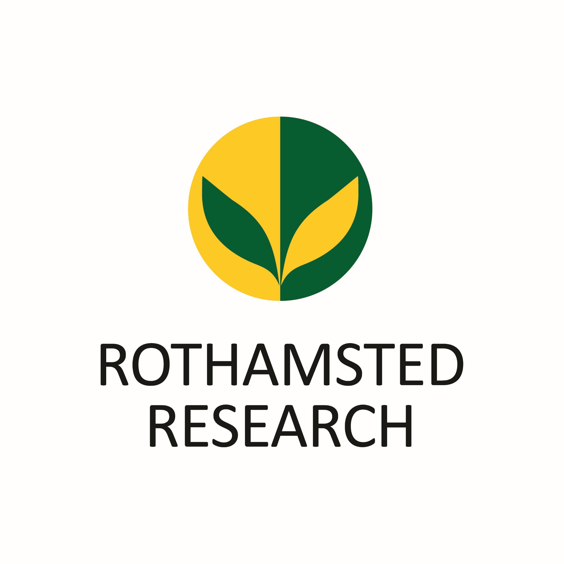

Lessons from
Broadbalk
Getting the most out
of wheat crops
Notes:
PowerPoint to accompany the “Lessons from Broadbalk” school activity created by Rothamsted Research that uses real data from the Broadbalk experiment. The activity is designed to get students interrogating data and comparing results while also considering the real life application for farmers and the practicalities that it involves.

Slide 2
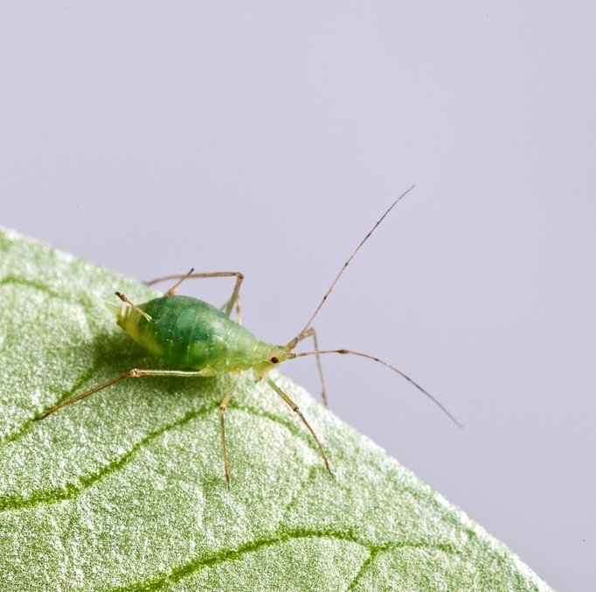
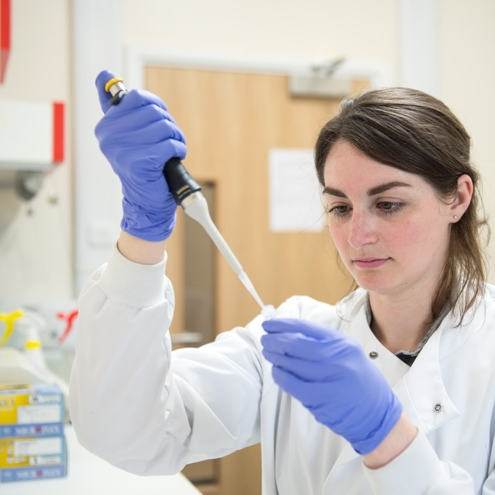
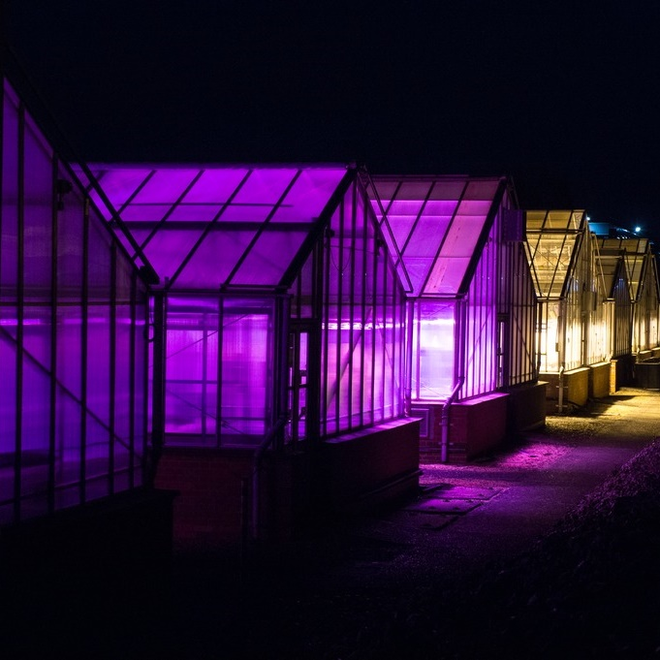
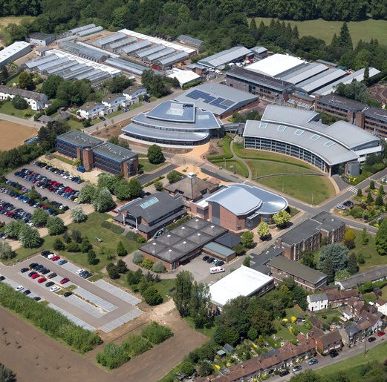
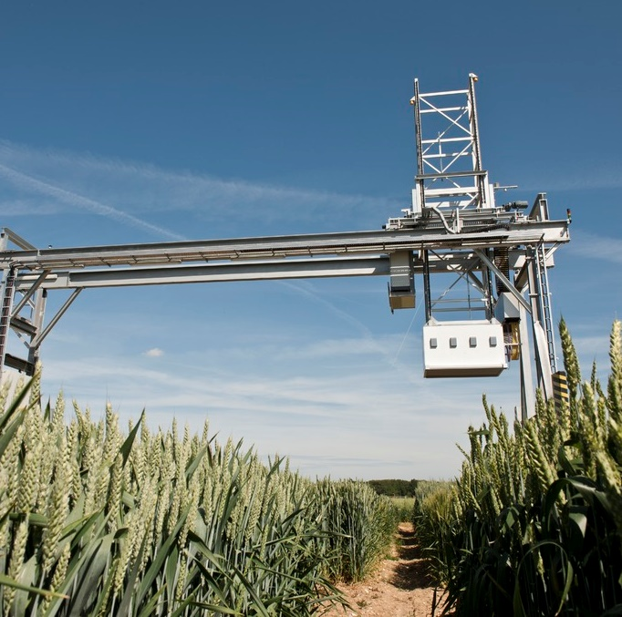
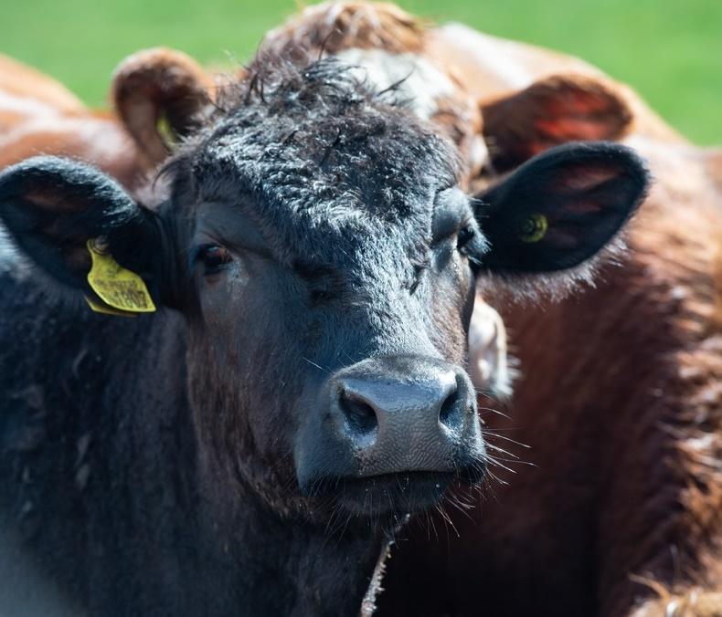
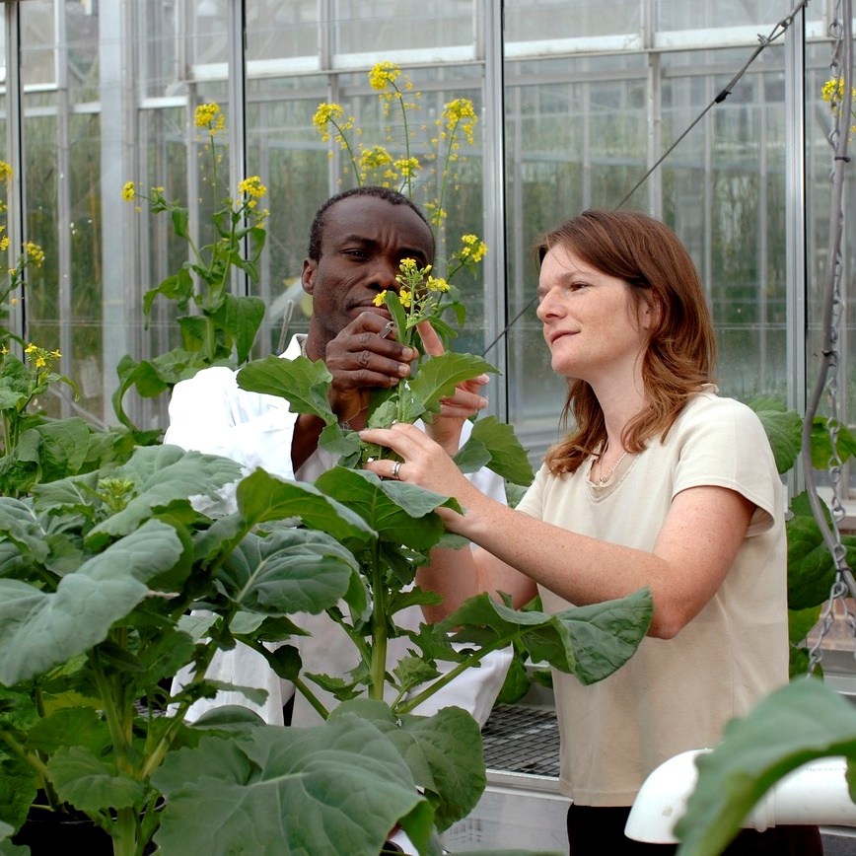
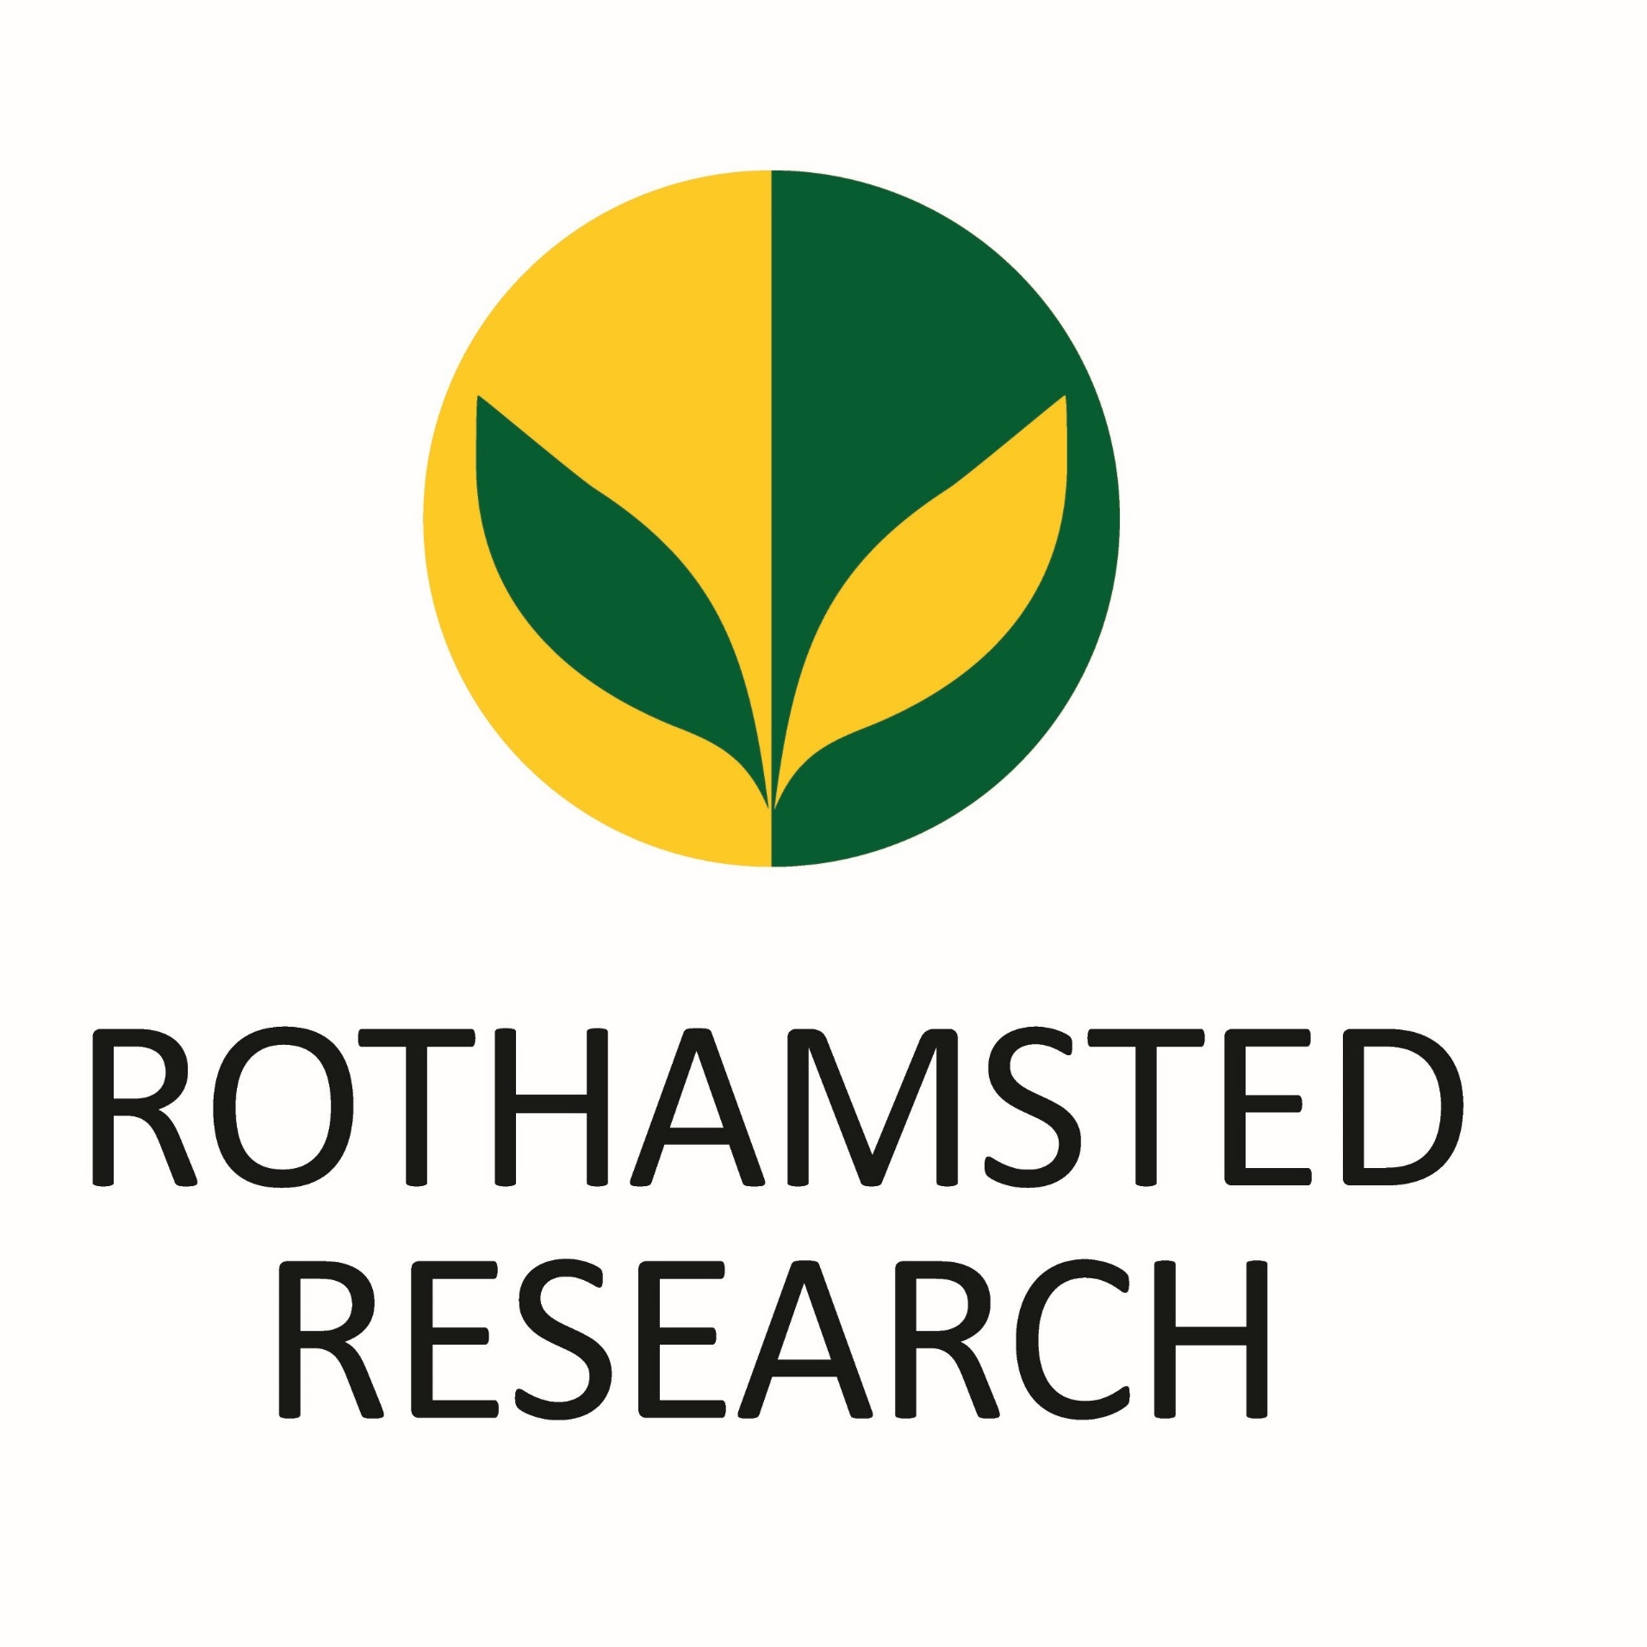
Rothamsted Research is a buzzing community of agricultural scientists all working to find answers to the question...
“How can we feed the world without harming the environment?”
Notes:
There are 2 main Rothamsted sites – Harpenden where lots of our crop research takes place and North Wyke (Devon) which is our livestock farm. We have over 300 scientists across our sites working in offices, labs, glass houses, fields and on farms.

Slide 3
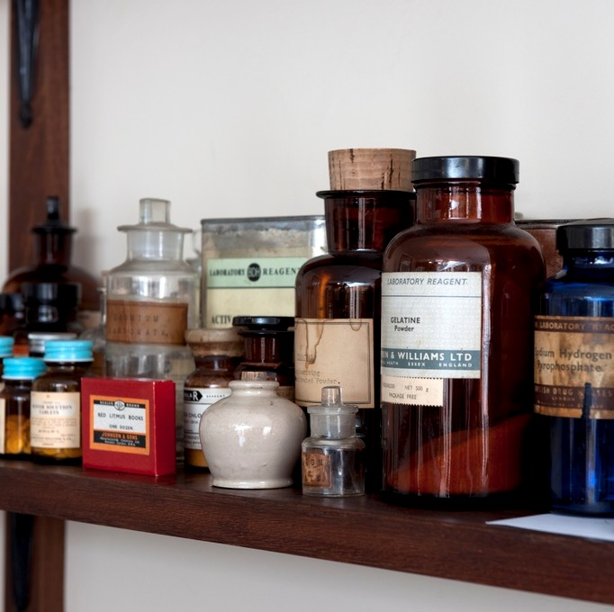
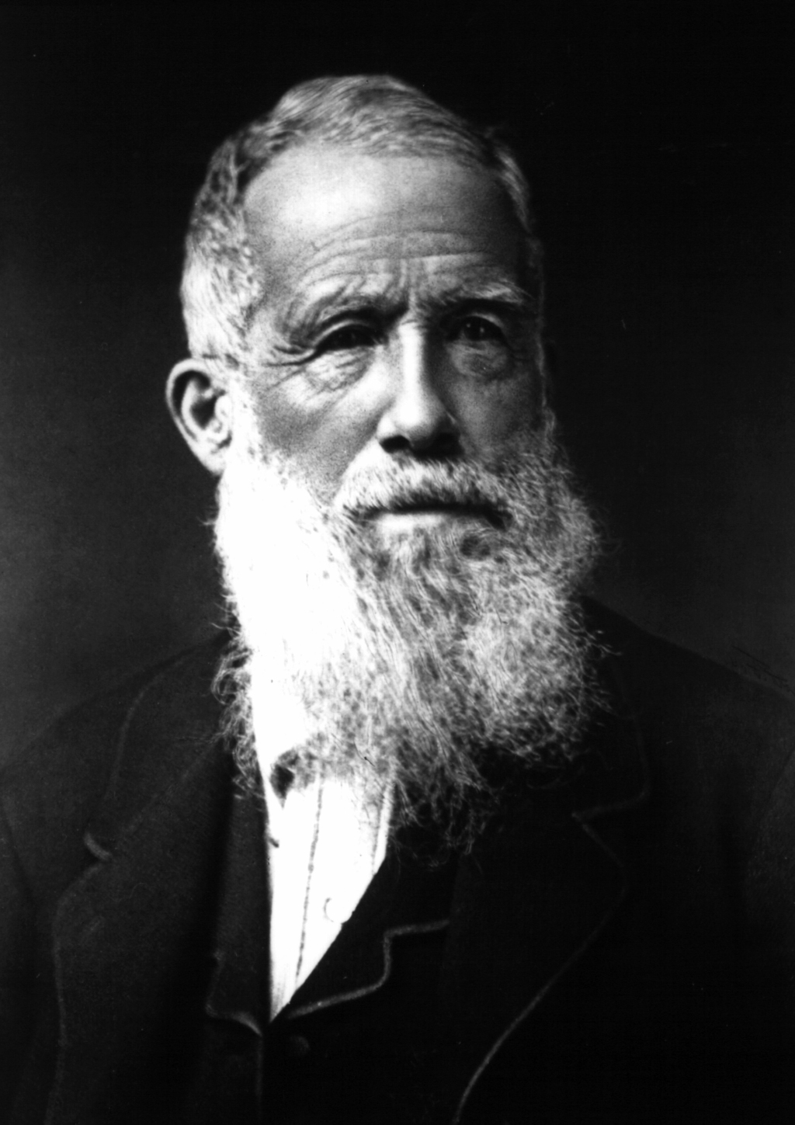

History of Rothamsted Research
John Bennet Lawes took over the Rothamsted estate in 1834.
He turned a bedroom of the manor house into a chemistry lab and experimented with animal bones and sulphuric acid to increase crop yields.
He started a successful fertiliser business in 1842.

Slide 4
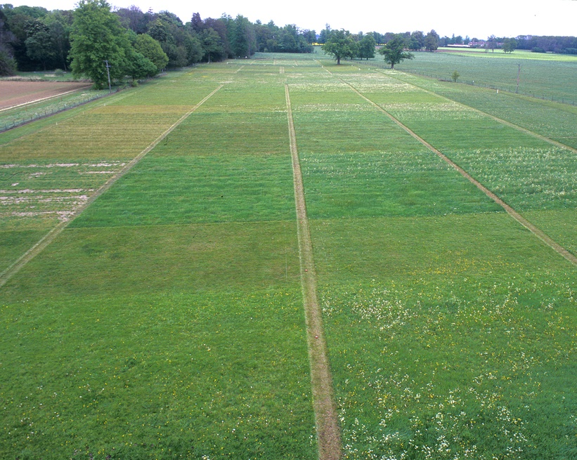
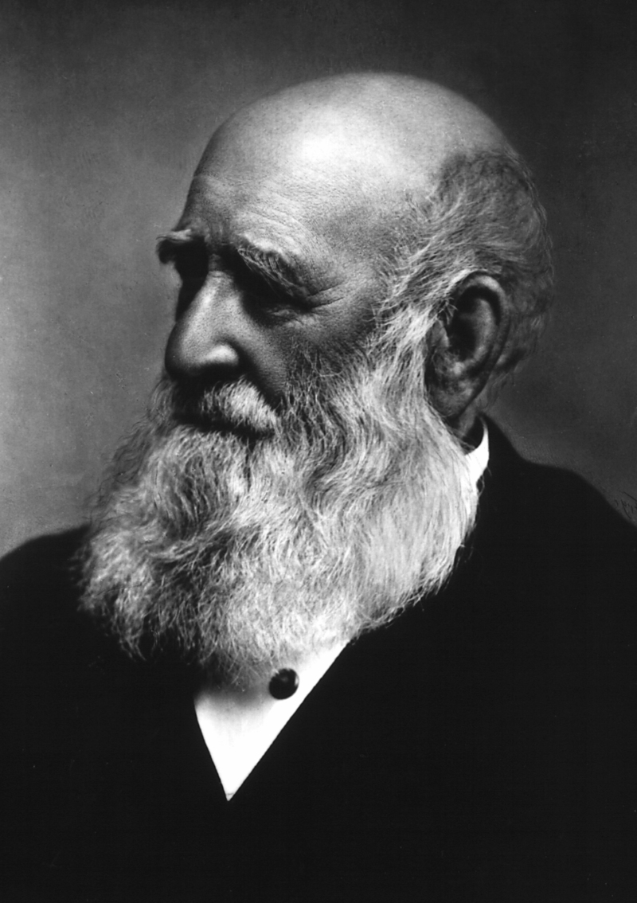
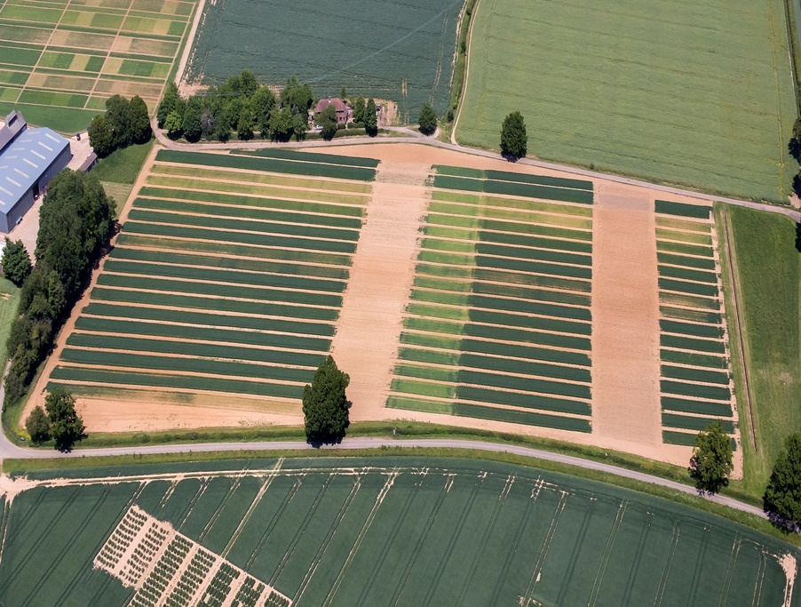
History of Rothamsted Research
Park Grass Field Experiment
He teamed up with the chemist Dr Joseph Henry Gilbert in 1843.
They started many long-term field experiments to how farmers could increase the yields of their crops.
9 of these experiments are still running today.
Including Broadbalk…
Broadbalk Field Experiment

Slide 5
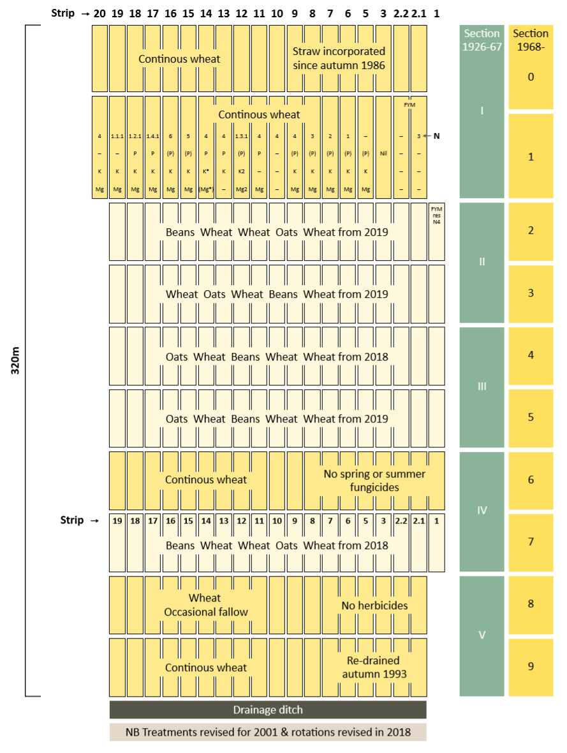
The Broadbalk Experiment
Set up in 1843 to compare different crop management and treatments on wheat yield.
The large field was originally split into long strips with each strip being treated in a different way.
The experiment has changed over time, to become more scientifically robust and to match modern farming practices.
Today the field is more like a grid of small plots.
Notes:
The Broadbalk experiment was started before modern statistics. They way scientists conduct experiments today is therefore very different so over the years the experiment has changed to keep inline with that and ensure that the science and results are robust. Other changes have also been introduced to match modern farming practices. This includes sections where wheat is grown in rotation with other crops (instead of wheat being grown every year across the whole experiement) and the introduction of herbicides and fungicides to control weeds and disease. The image shows how Broadbalk is set up today.
Wheat yield is how much wheat grain (measured in tonnes) is harvested per hectare (t/ha).

Slide 6
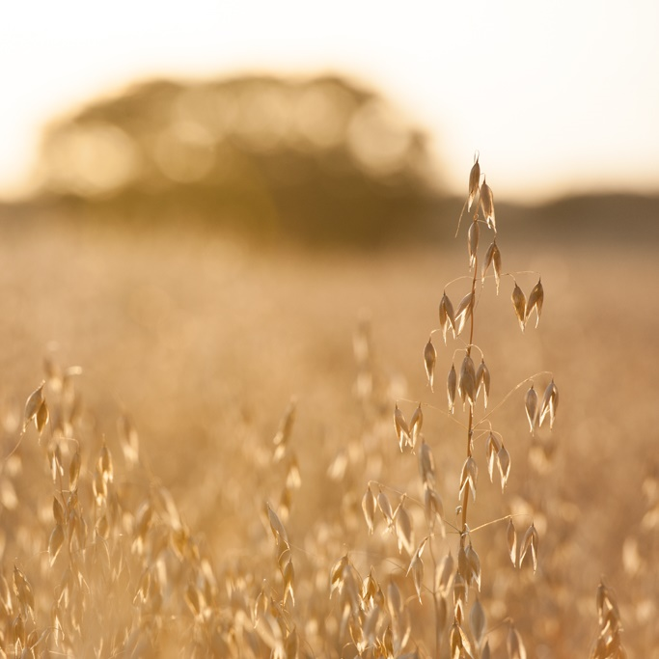
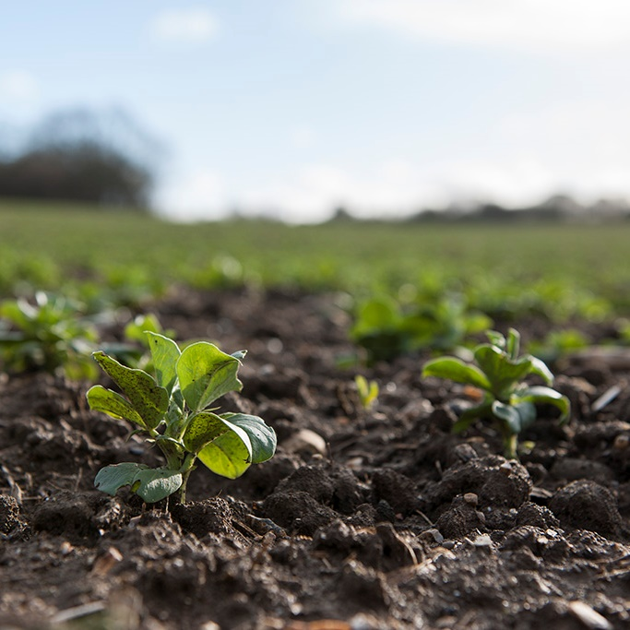
Farmers use fertilisers to add
nutrients to the soil
You are going to be using real data from Broadbalk to:
Compare wheat yields from plots grown using different fertiliser treatments.
Compare the results from plots where wheat is grown every year to plots where wheat is grown in rotation with other crops (called break crops).
N
FYM
Mg
K
P
Some farmers rotate the crops
that they grow every few years.
Notes:
N = Nitrogen, P = Phosphorus, K = Potassium, Mg = Magnesium, Fym = Farm Yard Manure
Three lesson aims
Visual can help to explain what fertilizers are used for and what we mean by rotation or continuous wheat.

Slide 7
Broadbalk Data
Wheat Yield:
The amount of wheat grain harvested
Measured in tonnes per hectare (t/ha)
Fertiliser Treatments:
Nil = No fertiliser
FYM = Farmyard Manure, an organic fertiliser
N1 to N6 = Inorganic fertilisers (manmade) with increasing levels of Nitrogen and the same quantities of K, P and Mg.
All plots being studied here have been treated with the same herbicides, pesticides and fungicides.
Notes:
Schematic shows the plots you are looking at today.

Slide 8
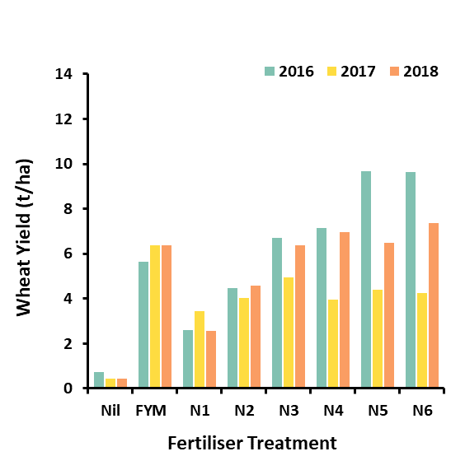
Continuous Wheat Results
What did you
notice about the data?

Slide 9
Continuous Wheat Results
Fertiliser has a positive effect on wheat yield.
FYM results in similar wheat yields to plots given N3-N6 fertilizer.
Increasing N results in greater yields until N3 when it levels out.
2017 often has lower yields that 2016 and 2018.

Slide 10
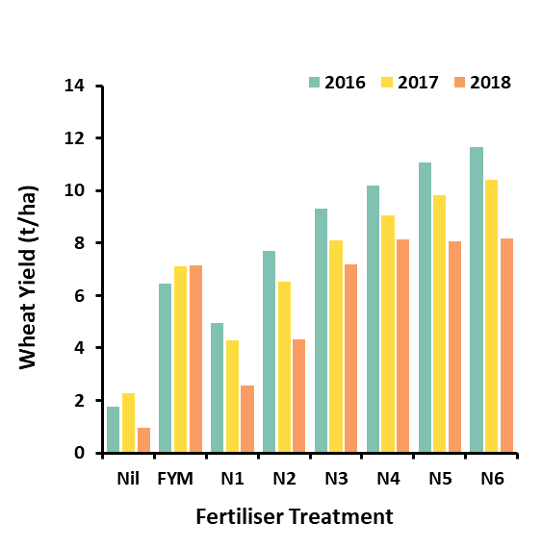
Rotational Wheat Results
What did you
notice about the data?

Slide 11
Rotational Wheat Results
Fertiliser has a positive effect on wheat yield.
FYM increases wheat yields, but not as much as plots treated with N3 to N6 fertilizer.
Increasing N results in greater yields but the trend slows down after N4.
Wheat yields appear to be decreasing each year.

Slide 12
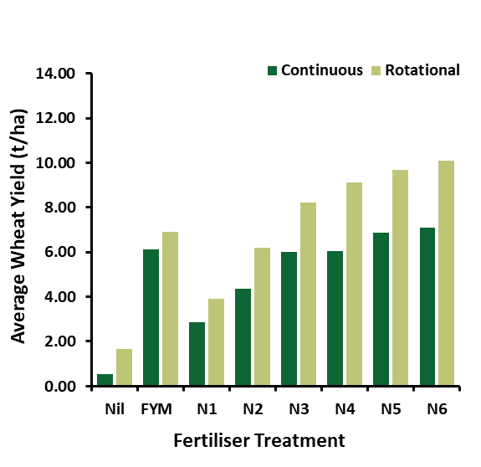
Continuous or Rotational Wheat?
Wheat grown in rotation with other crops tends to have a higher yield.
Why do you think this
might be?

Slide 13
Continuous or Rotational Wheat?
Wheat grown in rotation with other crops tends to have a higher yield.
Soil stability is increased
Different crops have different root systems helping to reduce soil erosion.
Soil nutrients are replenished
Different crops draw different nutrients out of the soil. Changing crops helps to stop the soil from becoming nutrient deficient.
Pests can be deterred
Specific pests attack specific crops. Rotating the crops force pests to move elsewhere.

Slide 14
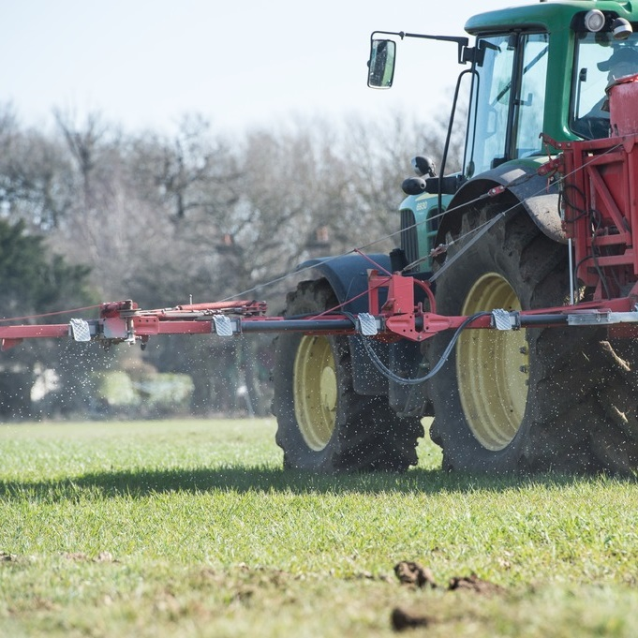
Conclusions
Different fertilisers give different results
Of the fertilisers looked at here FYM and N3-N6 fertilisers result in the highest wheat yields.
Rotating crops is best
Farmers can increase crop yield by changing the crops that a field is used to grow each year.
Long term data is important
Long running experiments give scientists lots of data helping them to see overall trends instead if year to year variations.

